Slide 1

Rockbuster Stealth Data Analysis Project
Lucero Vargas
12.2022

Slide 2

Background
Rockbuster Stealth LLC is a movie rental company that used to have stores around the world. Facing stiff competition from streaming services such as Netflix and Amazon Prime, we are planning to use our existing movie licenses to launch an online video rental service in order to stay competitive.
Key Questions and Objectives
Which movies contributed the most/least to revenue gain?
What was the average rental duration for all videos?
Which countries are Rockbuster customers based in?
Do sales figures vary between geographic regions?

Slide 3
Movies that contributed the most/least to revenue gain
All the bottom movies have a rental rate of $0.99!
All the top movies have a rental rate of $4.99!

Slide 4


Overview
The average rental duration price is $4.99
The top 3 genres are Sports, Foreign and Documentary. The least is Thriller with 1 movie.
Customers can be found in 108 countries around the world.

Slide 5
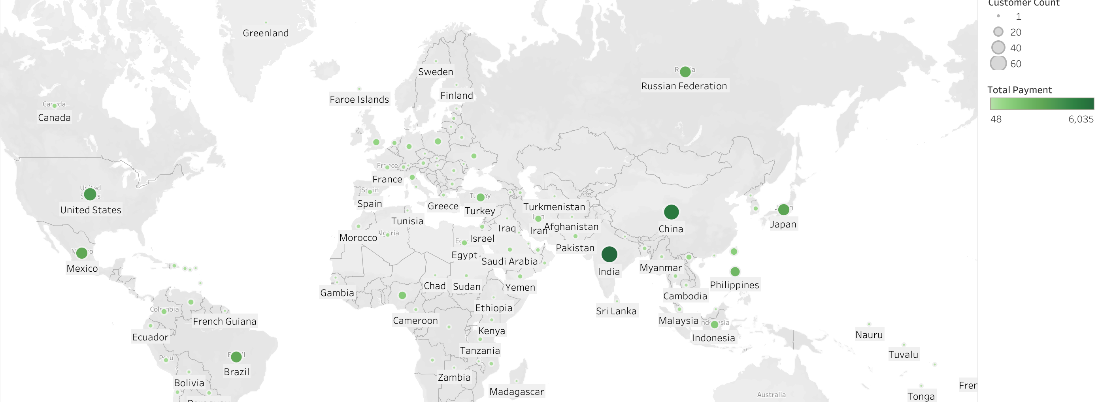
Countries with the Highest Revenue
India is the country with the highest customer count of 60 customers. China follows with 53 customers and The United States trails with 36 customers.
The top 3 countries with the highest revenues are:
India $6,034.78
China $5,251,03.
United States $3,685.31

Slide 6
Summary & Recommendations
Summary
The movies with the highest revenue have a rental rate of $4.99 while the movies with the lowest revenue have a rental rate of $0.99
The average rental duration price is at $4.99
Top 3 genres are Sports, Foreign and Documentaries
Asia is our highest region for profit and customer acquisition.
Recommendations
Research why Asia is our most profitable region.
Do an analysis on how much revenue the top 3 genres generate.

Slide 7
Thank You Lucero Vargas Lucero.v@rockbuster.com

